Slide 1
Epheszosz
Ephesus
Efes

Slide 2
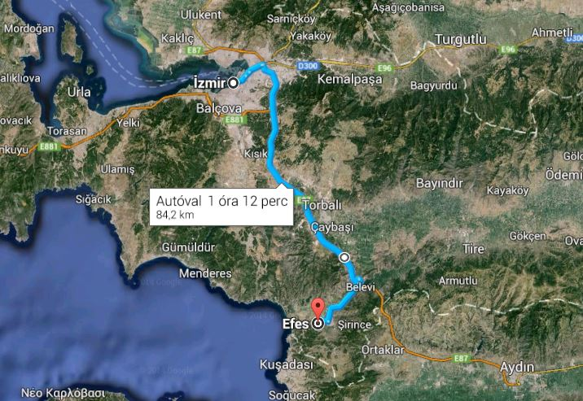
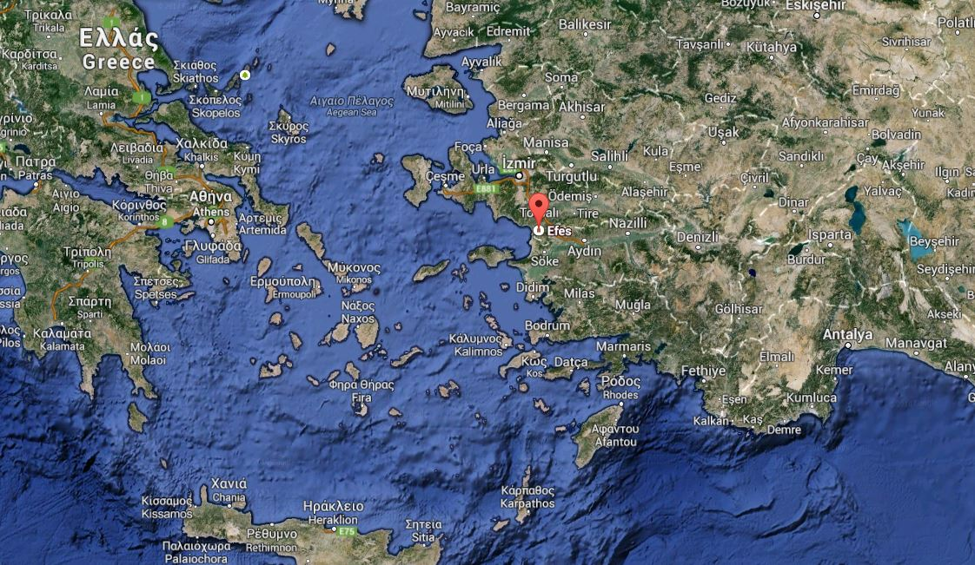
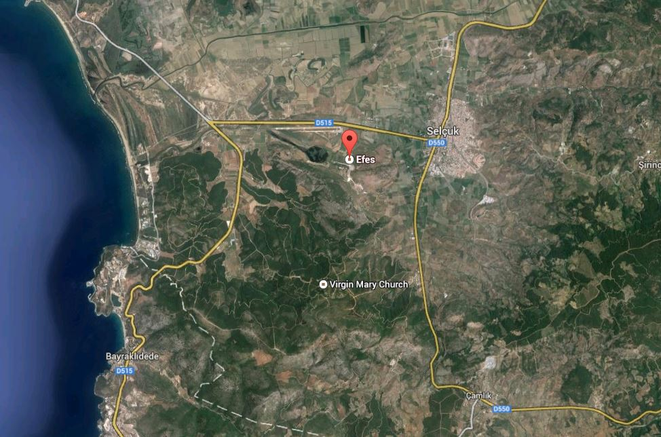
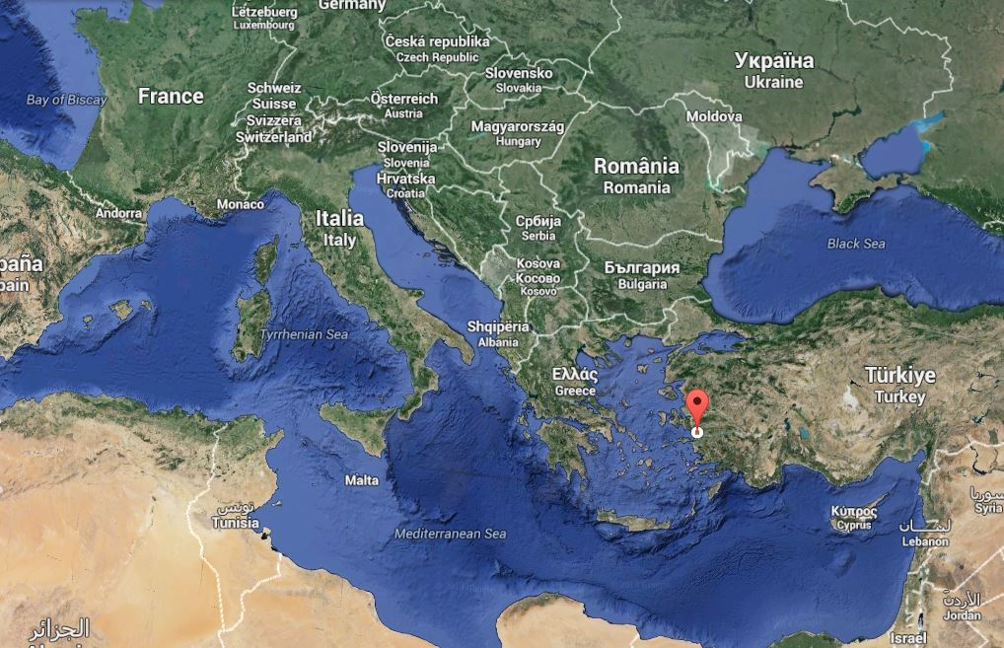
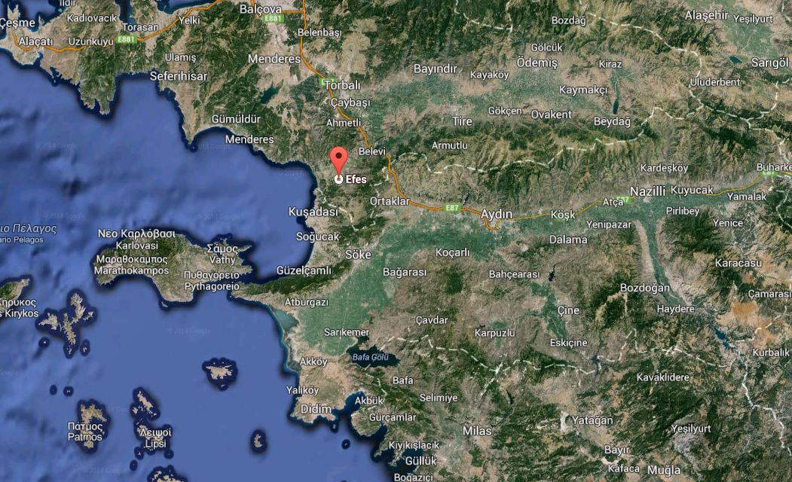
Ephesus on the map
Just 84km
from Izmir

Slide 3
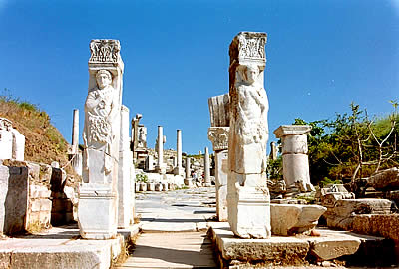
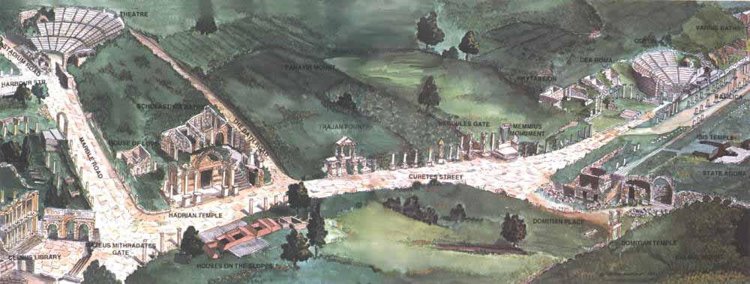
In the past:
•An ancient Greek city (10th century BC)
•Trade centre
•Religious centre of early Christianity
•An important port

Slide 4
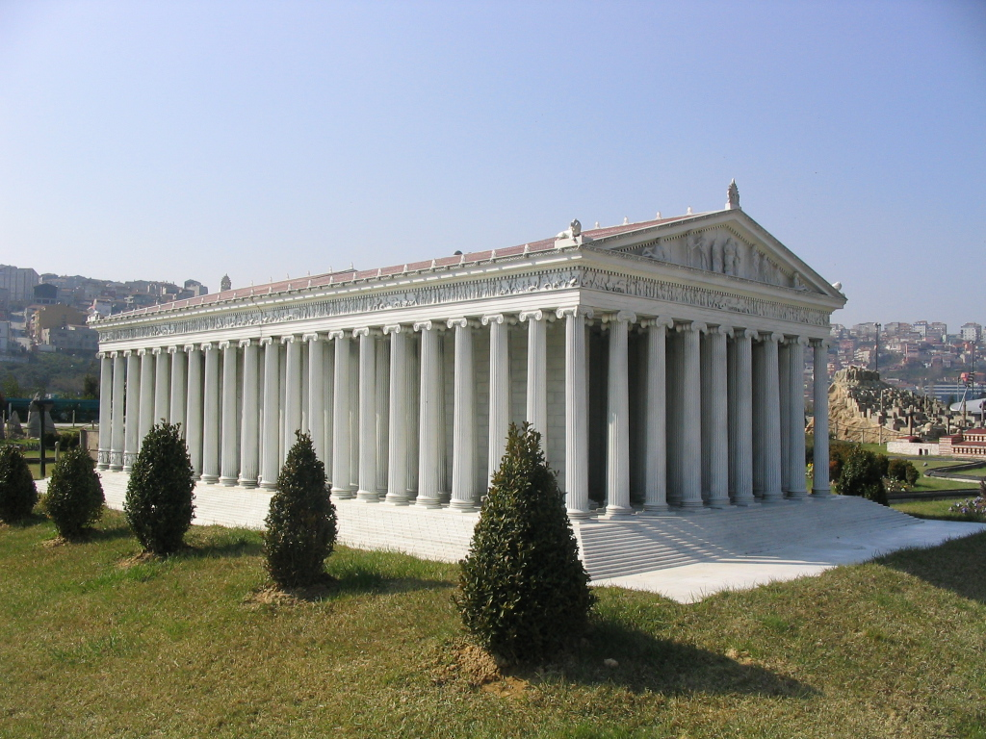
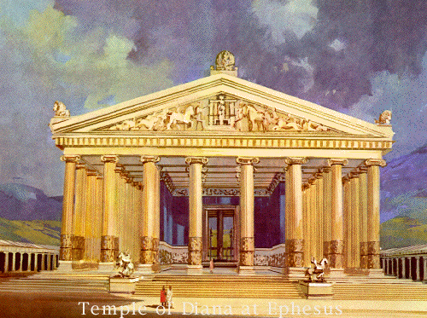
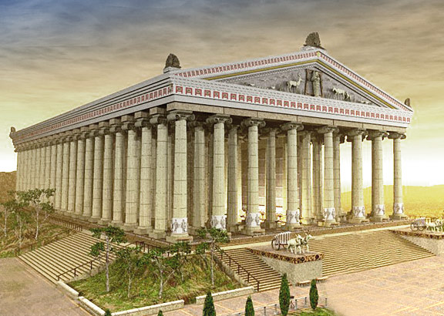
The TEMPLE of ARTEMIS
(a greek goddess)
•One of the seven wonders
of the ancient word
•Destroyed in 268 AD

Slide 5
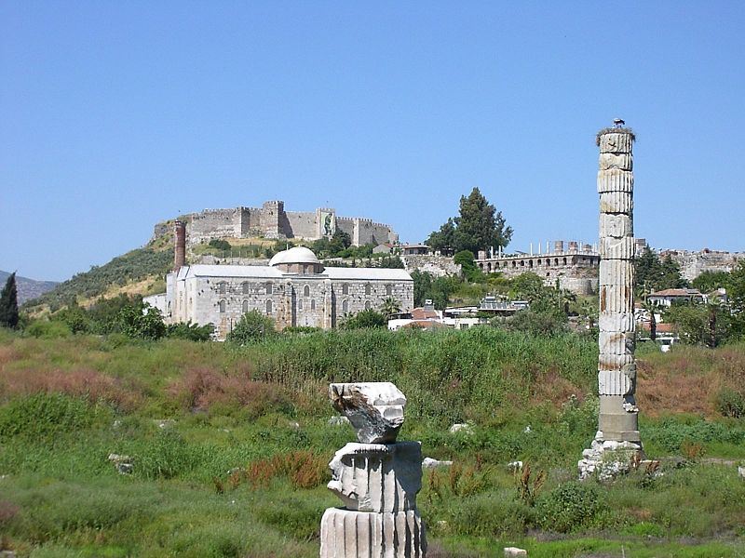
Today…

Slide 6
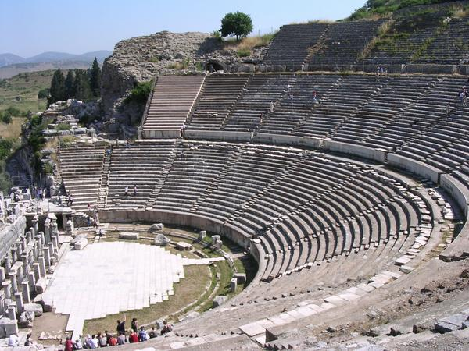
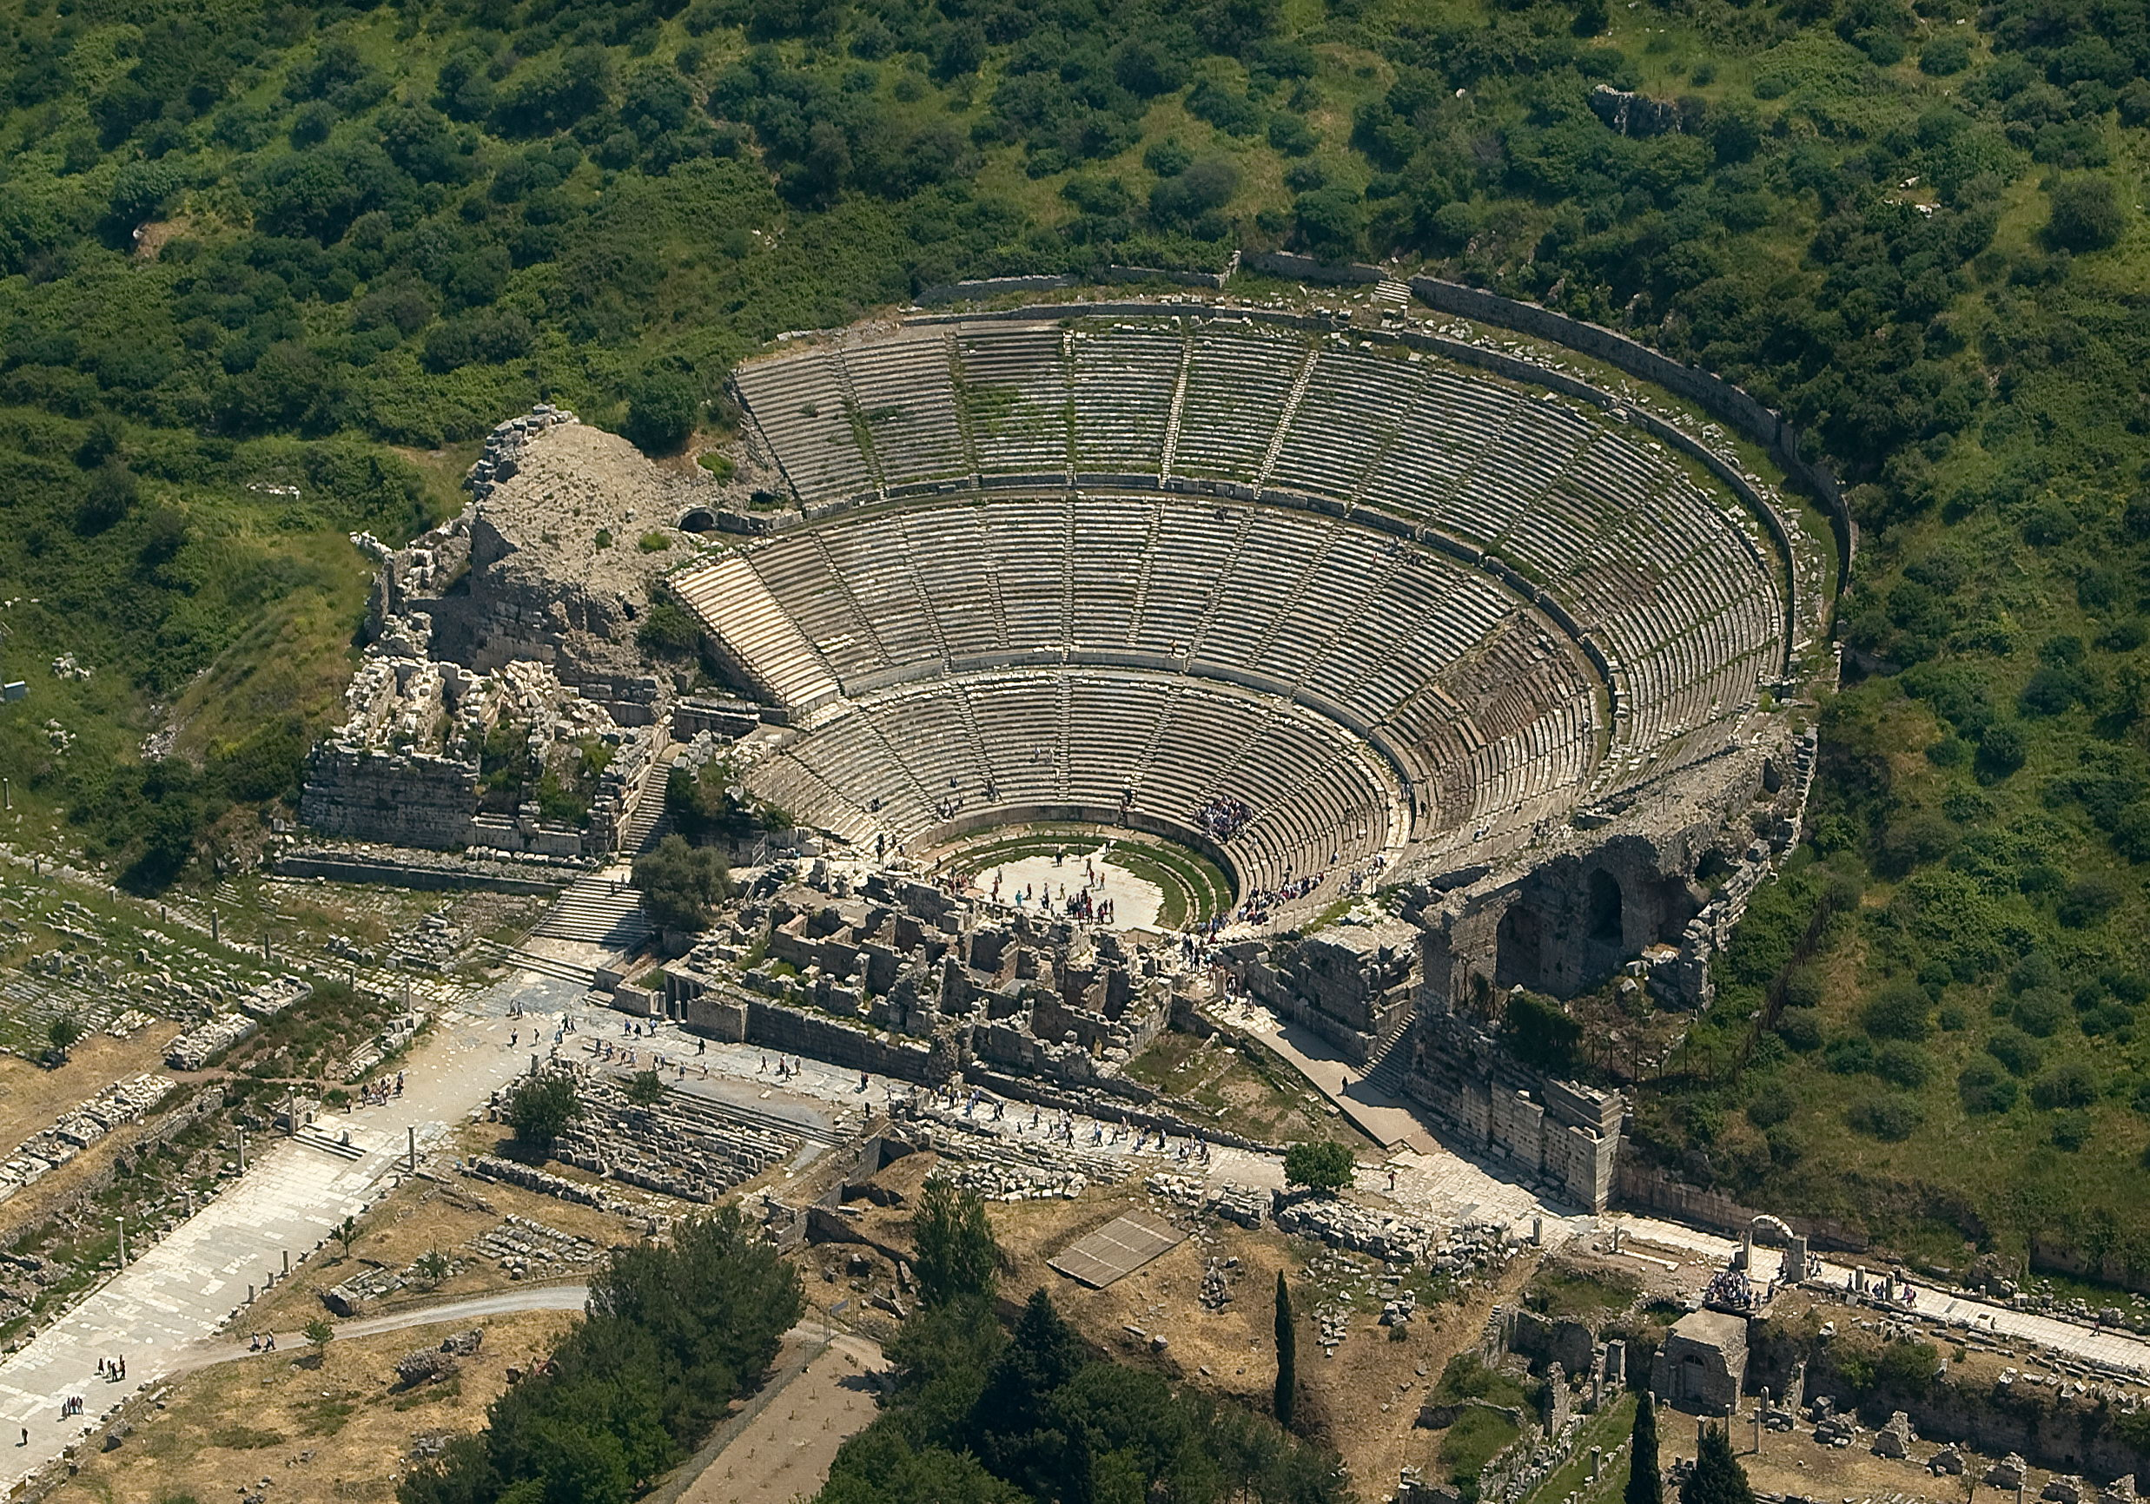
The ruins of Ephesus
•Famous tourist attraction:
Theater from the Roman period –
Largest outdoor theater

Slide 7
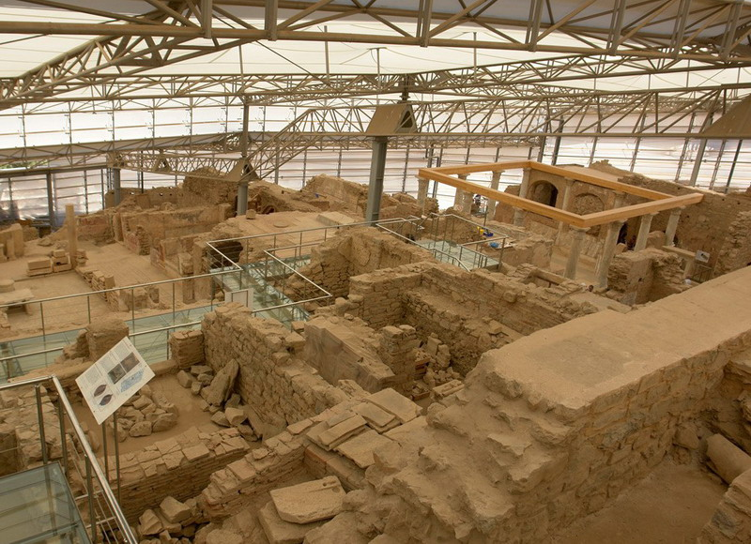
•The terrace houses of Ephesus

Slide 8
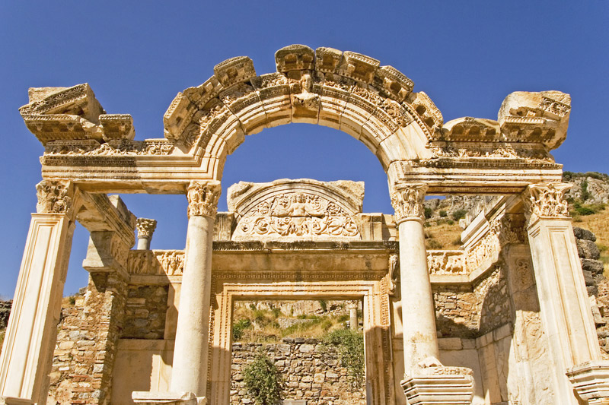
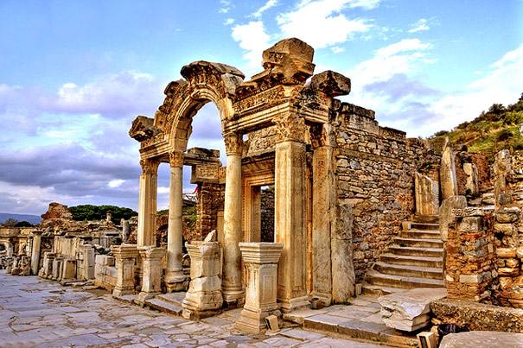
•Temple of Hadrian

Slide 9
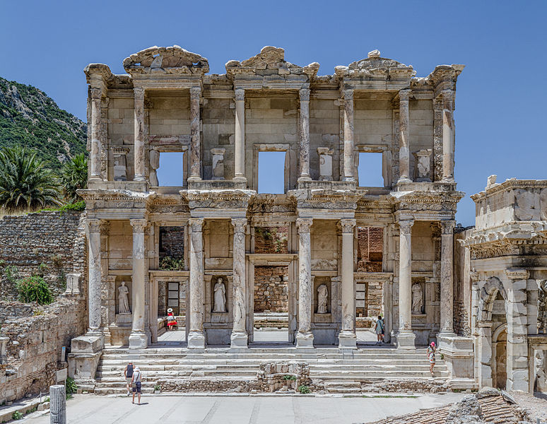
The library of Ephesus

Slide 10
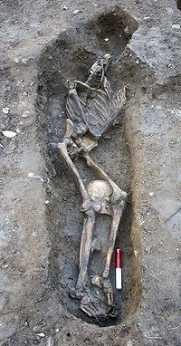
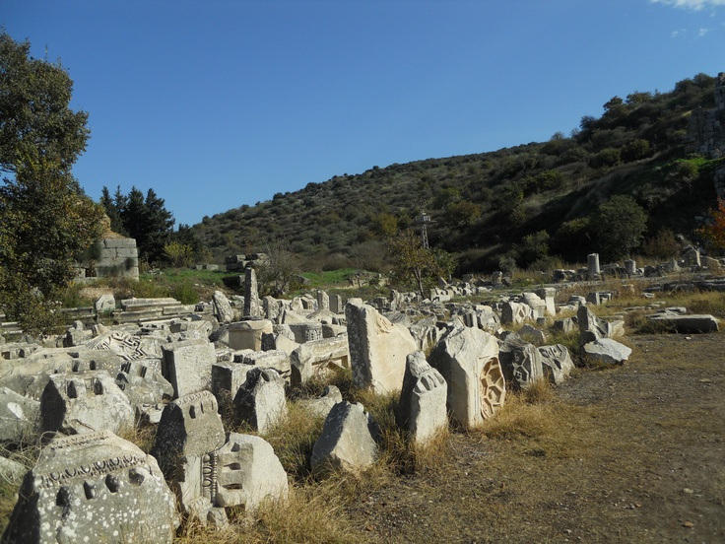
Gladiators graveyard

Slide 11
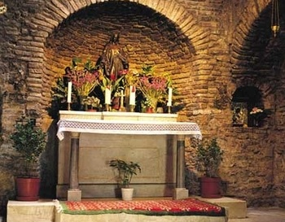
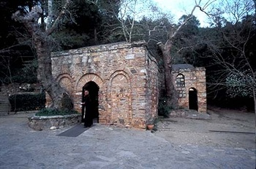
Ephesus and Christianity:
•Paul and John apostoles lived in Ephesus
•The house of the Virgin Mary is visited by
Pilgrims

Slide 12
Thanks for your attention
Enjoy the trip!☻

